Slide 1
Amazon Sales Data Analysis
Amazon is one of the leading E-commerce platform where users can buy millions of products from a lot of categories.

Slide 2
Introduction
Problem Statement
  Sales management has gained importance to meet increasing competition and the need for improved methods of distribution to reduce cost and to increase profits. Sales management today is the most important function in a commercial and business enterprise.
Objectives of the Study
  To find number of units sold by sales channel
  To find which is the bestseller Item type
  To find which mode of channel generated maximum sales
  To find yearly total sales
  To find total sales and total profit by region

Slide 3
The Process
Data Collection
Data Cleaning
Data Analysis
Insights
Summary

Slide 4
Data Collection
The Data has been collected in the form of a text file named “Amazon Sales Data.csv”.
The text file has the data of sales of products during the timespan of 2010 and 2017.

Slide 5
Data Cleaning
There were no Null values or blank fields in the data
Some values in ‘Order Date’ and ‘Ship Date’ columns are in String data
type. So we converted them to datetime datatype using Python
We also created a new variable named 'Days Shipping' which calculated
the number of days required to ship the orders
Most of the values in ‘Total Revenue’, ‘Total Cost’ and ‘Total Profit’ columns are written with two decimal places.

Slide 6
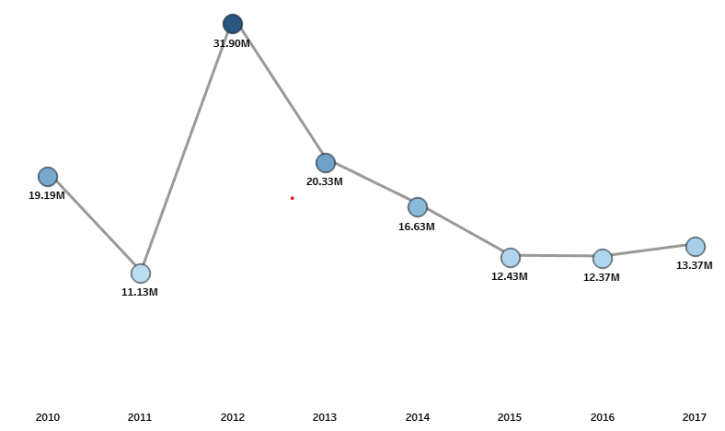
Data Analysis
Total Revenue by Year

Slide 7
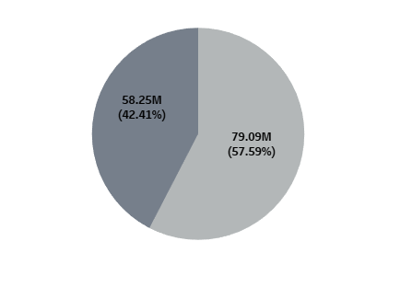

Data Analysis
Total Sales by Channel

Slide 8
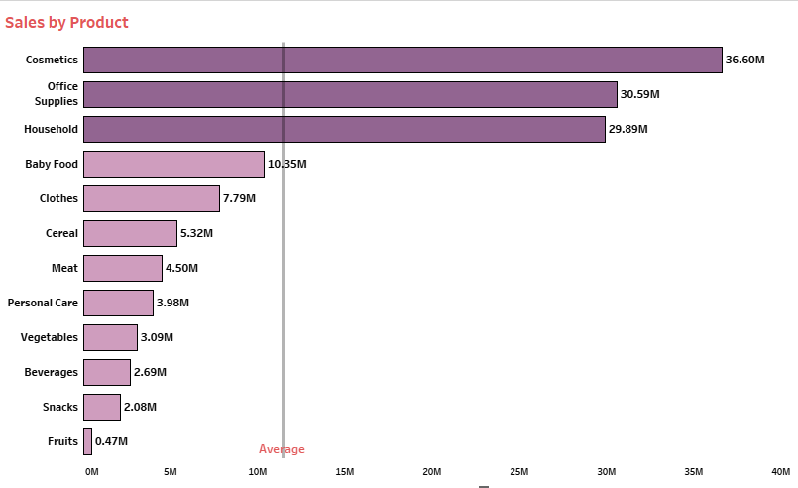
Data Analysis

Slide 9
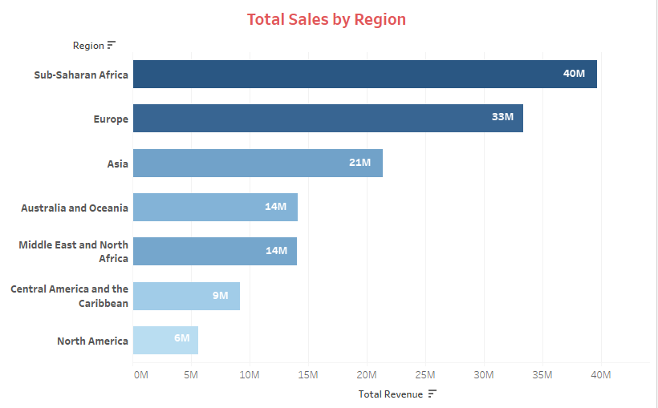

Data Analysis

Slide 10
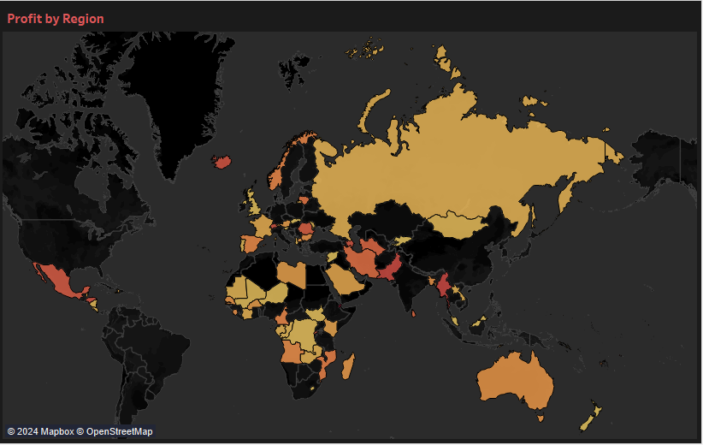

Data Analysis
Profit by Region

Slide 11
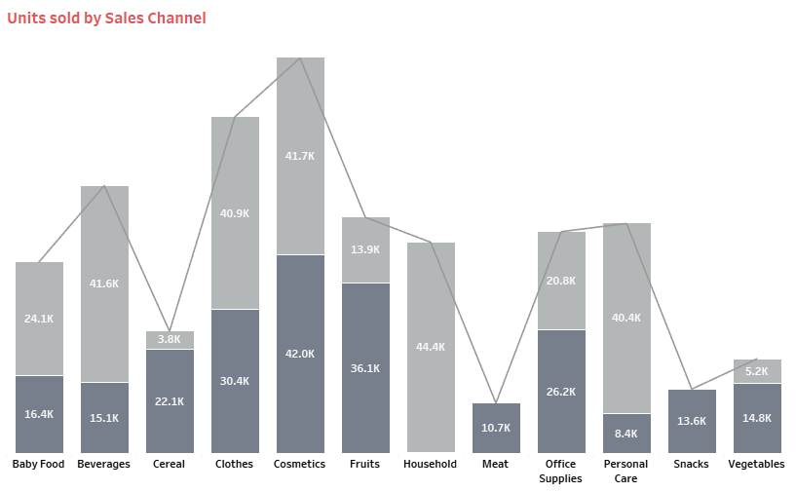
Data Analysis

Slide 12
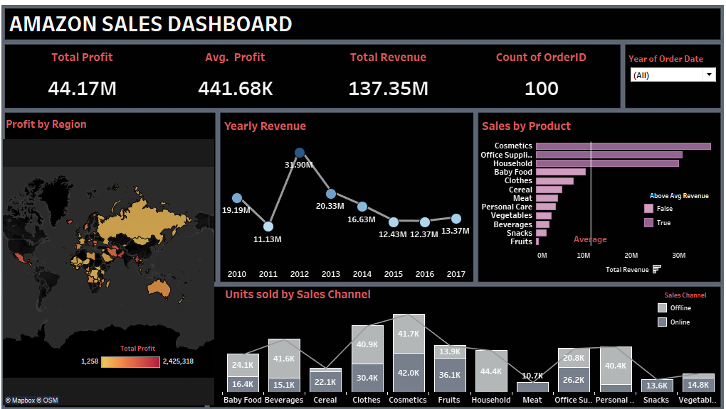
Data Analysis

Slide 13
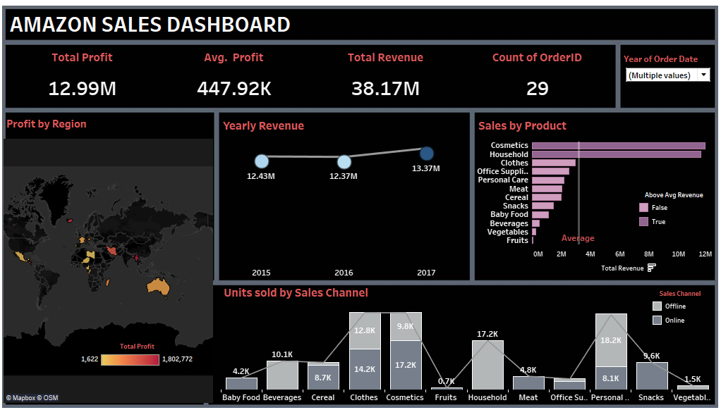
Data Analysis

Slide 14
Insights
The total revenue is 137.35M out of which total profit is $44.17M.
The average profit margin is 441.68K.
The “H” order priority gave the highest sales, which means people need their products fast.
“Cosmetics” products gave the highest sales.
Majority of people still prefer “Offline Channel” for buying products.
The year 2012 has seen the highest sales of around 32M.
The Sub-Saharan Africa region has seen the highest sales

Slide 15
Summary
Cosmetic products are very popular among people of Europe and these products generated the highest profit (14.56 M) of all items. So, it is advisable to create marketing campaigns promoting Cosmetic products.
Total Population of North America prefer to shop offline as compared to people of Europe, who prefer Online shopping. But because high profits are coming from Online channel, it advisable to promote products online.
The Region Sub-Saharan Africa has generated the highest profit where people bought Fruits the most, with around 31 thousands unit sold. Highlight the health benefits of fruits and align marketing with local preferences.
The second most purchased item, after Cosmetics in Europe is Baby Food. This insight tells us that majority of people of Europe are newly wed couples. Thus you can promote products related to new born babies to these people.

Slide 16
Summary
Fruits has generated the least profit of all item types which is only 120.50K. It is advisable to understand the customer needs, adjust the price and analyse the local preference.
North America has generated the least profit by selling only Personal Care and Household Items through Offline Channel. Try to promote products other than these items through Online Channel by giving discounts.
Meat is the least sold item with 11K units sold in Australia and Oceania and Sub-Saharan Africa Region using only Online Channel. Consider selling different kinds of meat products and adjust the prices.
Household Items and Cosmetic Products are sold the most through Offline and Online Channels respectively. Enhance physical stores with attractive displays and promotions for Household Items. Run targeted ads and make the website more user friendly for Cosmetic products.

Slide 17
Thank you

